Slide 1
Analytics FOR BUSINESS Intelligence
Fall 2021
Nuria Diaz-Tena
Notes:
Attendance and Seating

Slide 2
Course Planning
# | Date | Topic | Assignments | Wg
1 | 9/01/21 | Introduction, Visualizations & Exploratory Data Analysis - Chapter 1
2 | 9/15/21 | Introduction to R
3 | 9/22/21 | Statistical Experiments | Homework #1 | 5%
4 | 9/29/21 | Regression – Chapter 2 and 3 | Homework #2 | 5%
5 | 10/06/21 | Inference
6 | 10/13/21 | Models Review
 | 10/20/21 | Midterm Exam | Midterm | 20%
7 | 10/27/21 | Bayesian Models | Project #1 | 15%
8 | 11/03/21 | Classification Models – Chapter 4,Cross Validation Chapter 5 | Homework #3 | 5%
9 | 11/10/21 | Advance Classification Models - Chapter 9 | Homework #4 | 5%
10 | 11/17/21 | Support Vector Machines - Chapter 9
 |  | Thanksgiving Recess
11 | 11/29/21 | Review of Machine Learning Models
12 | 12/01/21 | Clustering - Chapter 10
13 | 12/06/21 | Project Discussion
14 | 12/08/21 | Final Exam Preparation | Project #2 | 15%
 | 12/15/21 | Final Exam | Final | 30%

Slide 3
To Review:
Homework # 2 Review
Gauravkumar Vishwakarma
Niyati Aggarwal
Zida Wang
Linear Regression Summary
Haoyu Wang

Slide 4
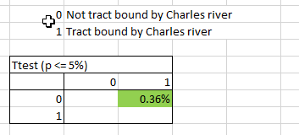
Is the median value of owner- occupied homes different between the neighborhoods next to the Charles river and the ones not next to the river?
Gauravkumar Vishwakarma
Conclusions and Test Results :
Ans : As we can clearly see from the boxplot graph, the average prices of homes tract bound by Charles River is higher. Also, from the T-test we can conclude that there exists a statistically significant difference between the owner-occupied homes next to Charles river and the ones not next to it.
So, in conclusion we can see that the median values of owner-occupied homes is higher near the Charles river as compared to the homes further away from Charles river.

Slide 5
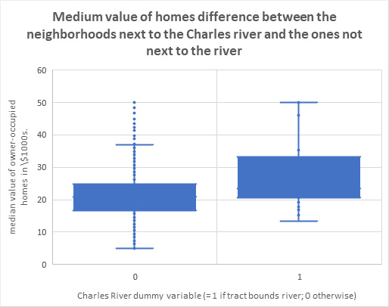
Visualizations :
Gauravkumar Vishwakarma

Slide 6
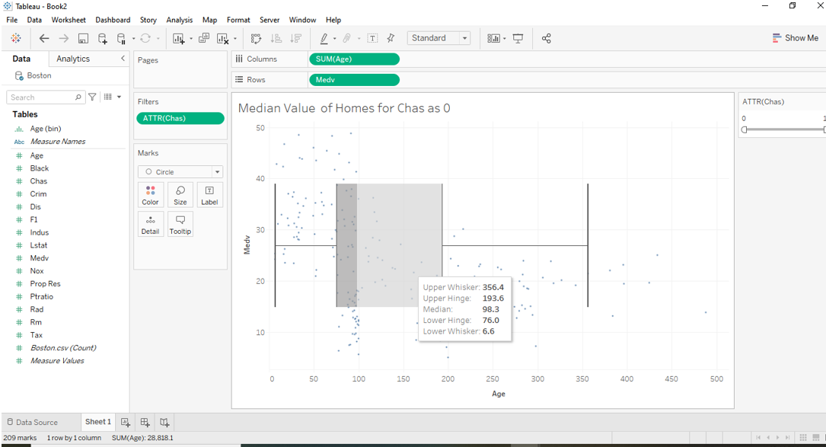
Gauravkumar Vishwakarma

Slide 7
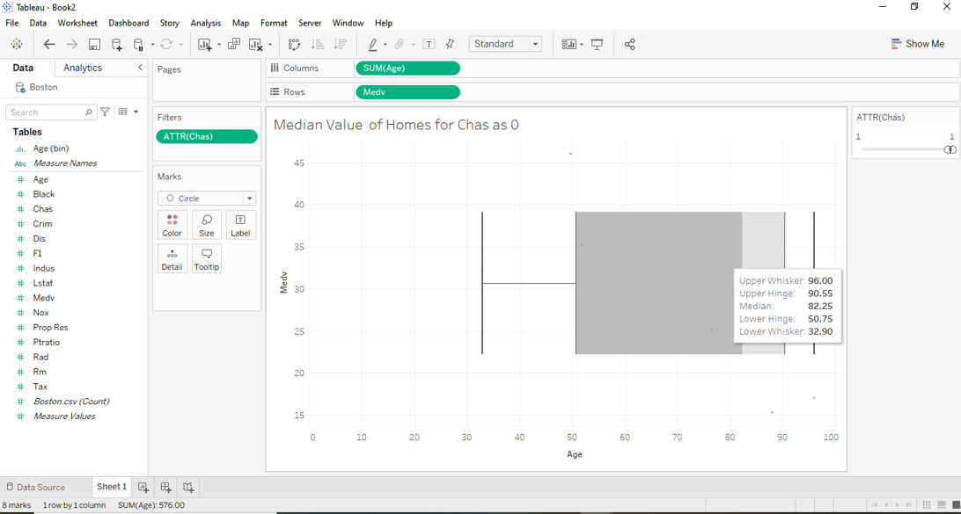
Gauravkumar Vishwakarma

Slide 8
Why different test provide different results?
H₀ : Equal Means
H_{a} : Different Means
t-Test: Two-Sample Assuming Unequal Variances
 | Variable 1 | Variable 2
Mean | 22.09384289 | 28.44
Variance | 77.99296201 | 139.633059
Observations | 471 | 35
Hypothesized Mean Difference | 0
df | 37
t Stat | -3.113291313
P(T<=t) one-tail | 0.001780218
t Critical one-tail | 1.68709362
P(T<=t) two-tail | 0.003560435
t Critical two-tail | 2.026192463
t-Test: Two-Sample Assuming Equal Variances
 | Variable 1 | Variable 2
Mean | 22.09384289 | 28.44
Variance | 77.99296201 | 139.633059
Observations | 471 | 35
Pooled Variance | 82.15122251
Hypothesized Mean Difference | 0
df | 504
t Stat | -3.996437466
P(T<=t) one-tail | 3.69531E-05
t Critical one-tail | 1.647882577
P(T<=t) two-tail | 7.39062E-05
t Critical two-tail | 1.964682003
t.test(Boston.df.onriver$medv,Boston.df.offriver$medv)
Welch Two Sample t-test
data: Boston.df.onriver$medv and Boston.df.offriver$medv
t = 3.1133, df = 36.876, p-value = 0.003567
alternative hypothesis: true difference in means is not equal to 0
95 percent confidence interval:
2.215483 10.476831
sample estimates:
mean of x mean of y
28.44000 22.09384
Tukey multiple comparisons of means
95% family-wise confidence level
Fit: aov(formula = medv ~ chas, data = Boston)
$chas
diff lwr upr p adj
1-0 6.346157 3.226333 9.465981 7.39e-05

Slide 9
Z and T Distribution

Slide 10

Rakshit Manohar Karkera

Slide 11
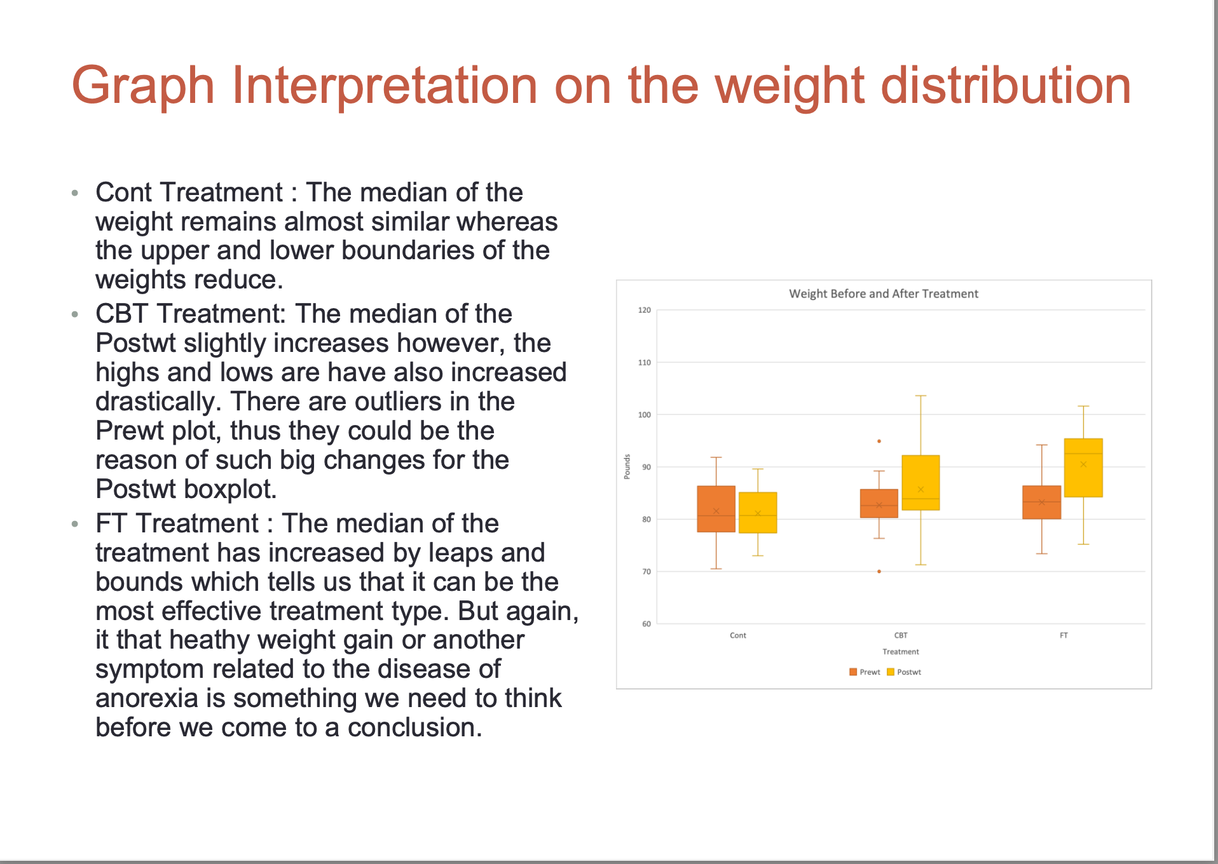
Rakshit Manohar Karkera

Slide 12
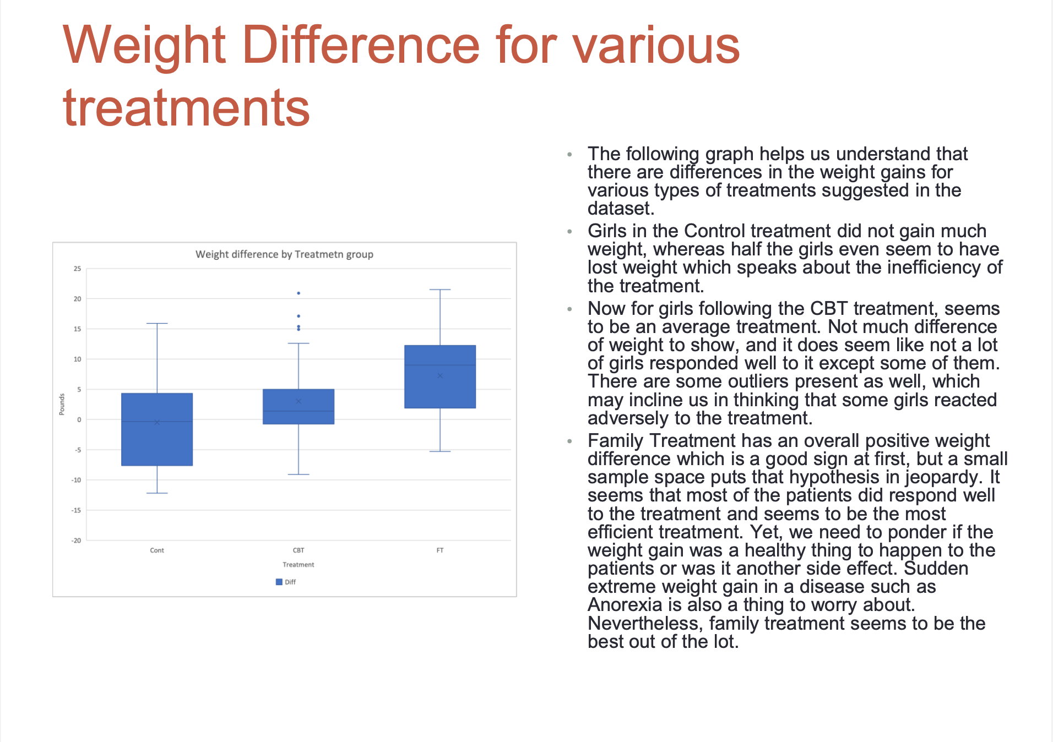
Rakshit Manohar Karkera

Slide 13
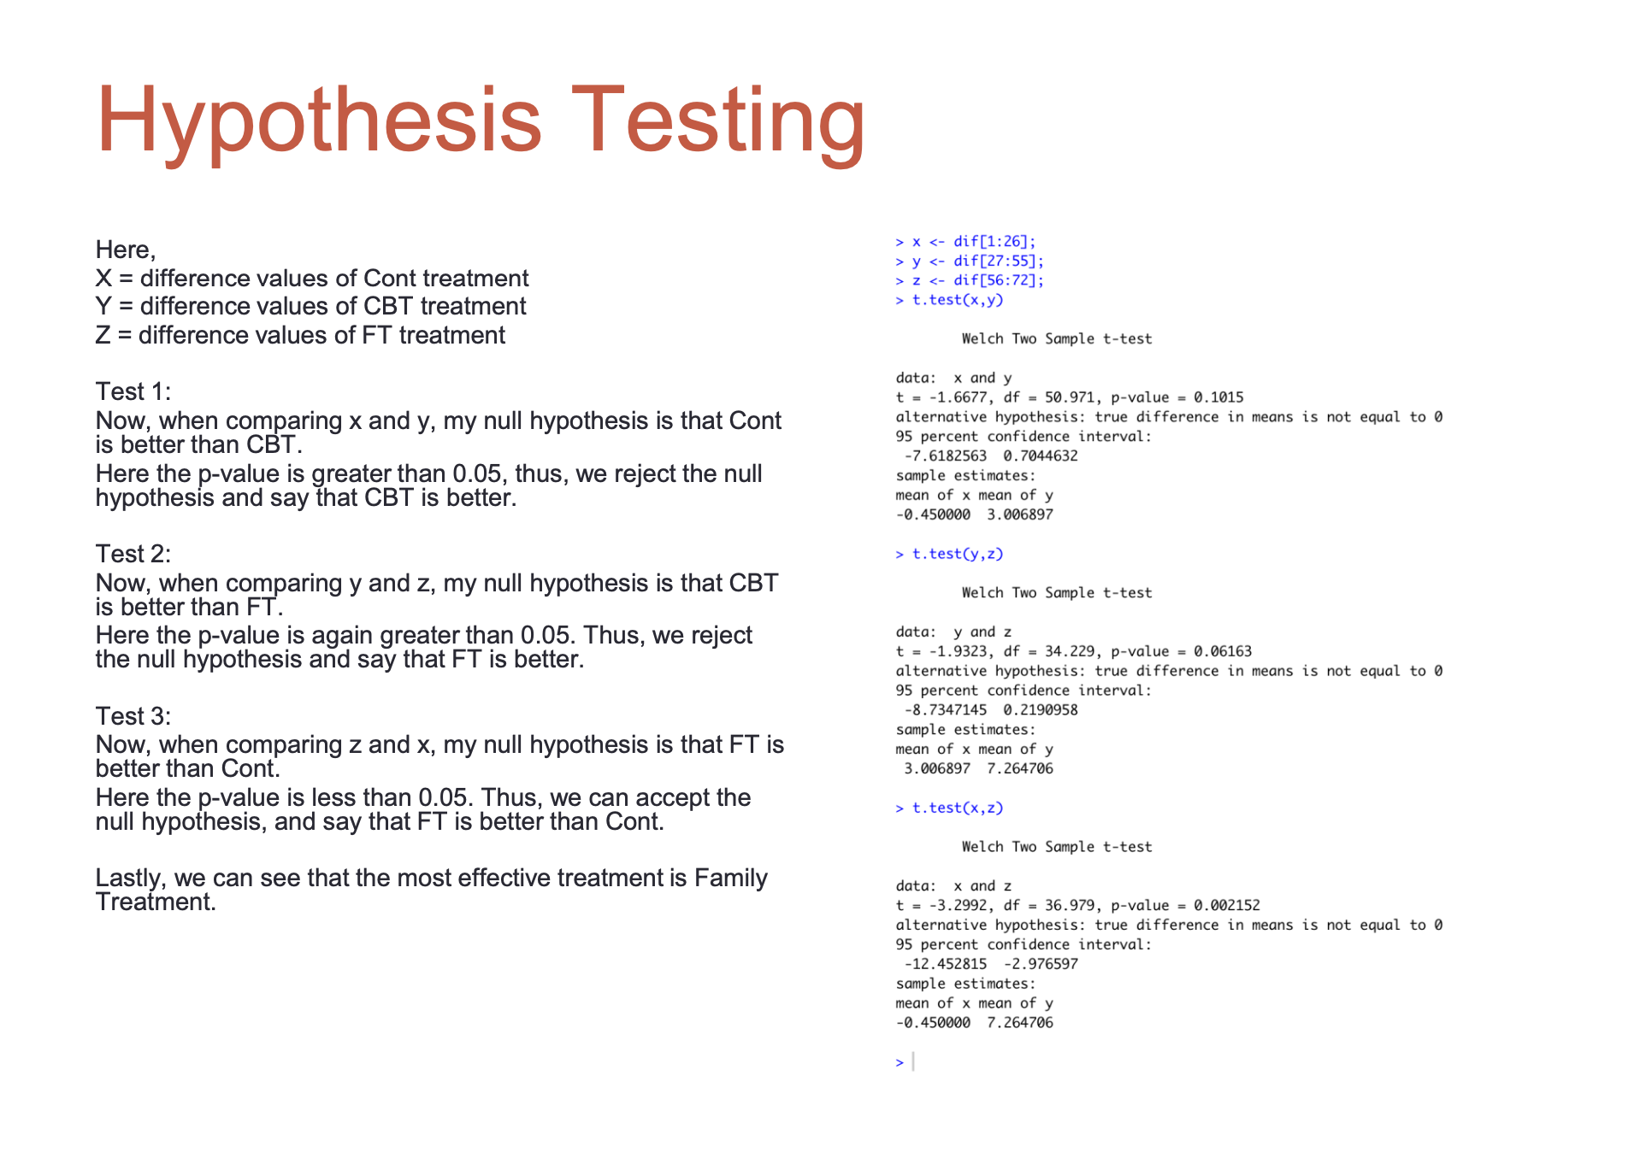
Rakshit Manohar Karkera

Slide 14
How to Sample Badly 6 (answer)
Niyati Aggarwal
Convenience samples invite bias because
They are more cost effective.
They are easier to conduct.
They attract those with strong opinions.
The survey participants tend to have similar characteristics that impact the response variable (correct).

Slide 15
Can You Trust a Sample? (answer)
Niyati Aggarwal
The first question to ask of any sample is
Did it cost a lot of money?
Was a table of random digits used?
Was random sampling used? (correct)

Slide 16
From Sample to Population 7 (answer)
Niyati Aggarwal
Consider all 5000 undergraduate students at a local university to be a population. The average grade point average (GPA) for this population is 3.27. A sample of 100 of these undergraduate students is randomly selected, and the sample GPA is found to be 3.47.
Identify the parameter.
3.27 (correct)
3.47
100 undergraduates
5000 undergraduaates

Slide 17
Sampling Variability 5 (answer)
Niyati Aggarwal
In order to reduce bias, one should
take a smaller sample size.
take a larger sample size.
be sure to use the best random sampling scheme. (correct)

Slide 18
Sampling from Large Populations (answer)
Niyati Aggarwal
A simple random sample of size n = 150 was taken from a population of size 250,000. Another simple random sample of size n = 150 was taken from a population of size of 100,000.
Which sample will yield a statistic with less variability?
The first SRS will have less variability since the population is larger.
The second SRS will have less variability since the population size is smaller.
The variability will be similar since the sample sizes are the same. (correct)

Slide 19
Nonsampling Errors 2 (answer)
Niyati Aggarwal
It is widely known that respondents to surveys will not be honest when asked “sensitive questions”—that is, questions they may be embarrassed to answer truthfully.
Surveys containing sensitive questions suffer from
response error (correct)
nonresponse error.
processing error.
undercoverage.

Slide 20
Sample Design in the Real World 5 (answer)
Niyati Aggarwal
A researcher wants to estimate the proportion of voters in a particular state that will vote in the next election. She decides to survey adults in the state, but she wants to make sure each county is represented in her sample. Which type of sampling method would be best for the researcher to use?
Convenience sample
Stratified sample (correct)
Systematic sample
Simple random sample

Slide 21
How to Sample Badly 1 (answer)
Niyati Aggarwal
A statistical study is said to be biased if
It is not a census.
The response variable is not well defined.
It systematically favors a certain outcome (correct).
Repetitions of the same study yield different results.

Slide 22
Simple Random Samples 1 (answer)
Niyati Aggarwal
A simple random sample is better than a voluntary response or convenience sample because it
Is easier to carry out.
Attracts individuals that feel strongly about the topic.
Avoids bias (correct).

Slide 23
From Sample to Population 1 (answer)
Niyati Aggarwal
A purchaser for a large convenience store chain wants to know if the shipment of 1,000,000 batteries he is receiving is a good one. He randomly selects 100 batteries from the shipment and tests their charge. Two of the batteries did not have a full charge.
Identify the parameter.
1,000,000 batteries in the shipment
100 randomly selected batteries
2% = the percent of the 100 selected batteries that do not have a full charge
Percent of the 1,000,000 batteries that do not have a full charge (correct)

Slide 24
Project due 10/27:
Project # 1
Life expectancy
1. What is the best model to predict life expectancy with the data provided in the following two links?
https://www.worldometers.info/demographics/life-expectancy/#countries-ranked-by-life-expectancy
https://www.worldometers.info/world-population/population-by-country/
2. Which other variables could you include in the model to improve predictions of life expectancy?
Median Value of Own houses in Boston area
What I the best model to predict the median value of the houses in the Boston area?

Slide 25
To Review:
Homework # 2 Review
Gauravkumar Vishwakarma
Niyati Aggarwal
Zida Wang
Linear Regression Summary
Haoyu Wang

Slide 26
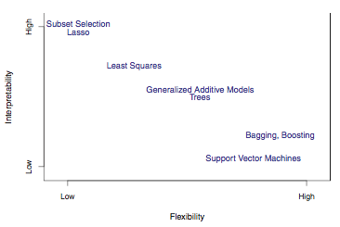
Types of Models
Model Form
Response Type
Parametric Model
f(X) = β0 +β1X1 +β2X2 +...+βpXp linear model
Regression Model
Numerical Response
Linear Regression
K-Nearest Neighbor
Boosting
Classification Model
Categorical Response
Logistic Regression
K-Nearest Neighbor
Boosting
Non-Parametric Model
f(X) = any model form of x flexible model

Slide 27
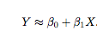
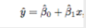
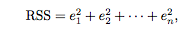
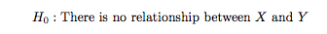
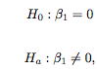
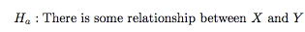
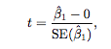
Linear Regression
Intercept. slope
Estimate Intercept and slope by minimizing the
Residual Sum of Squares (RSS)
Y =f(X)+ε actual +ε
ˆ Ŷ= f(X) predicted
input variables
independent variables
feature variables
Predictors
Drivers
output variable
response
dependent variable
Error Term
P-value –
the probability of observing any number equal to |t| or larger in absolute value, assuming β₁ ^{= 0.}

Slide 28
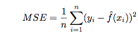
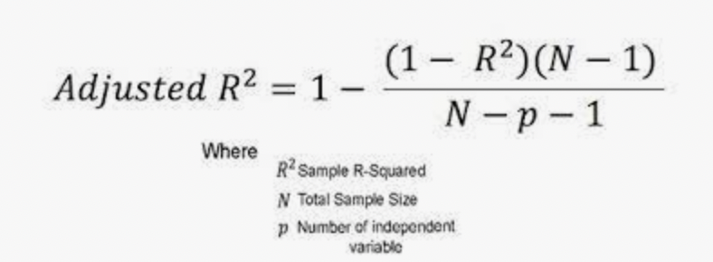
Error Discussion
Differences and relationships between:
RSS –Residual Sum of Squares
MSE - Mean Square Error
RSE - Residual Standards Error = sqrt(RSS/(n − 2))
R-Square = 1- TSS/RSS
Adjusted R-Square
AIC = n log(Var)+2K. (K number of predictors
MAPE – “Mean Absolute Percent Error”
Correlation
* TSS : Total Sum Squares ( Sum of square difference between y and mean(y))
Regression is better when:
Adjusted R-Square as close as possible to 1
AIC as small as possible

Slide 29
Model Diagnostics, Significance and Fit
Check Residual plot:
Are the residuals around 0 with no pattern?
If not, there may be a better form instead of linear
Are the residuals of equal value in all independent values?
If not, the residuals have heteroscedasticity instead of homoscedasticity and it is suggested to use logs.
Outliers.
Check for outliers on the residual plot. Do this outliers affect the predictions?
High-leverage points. Very influential points
Check the leverage versus residual plot
Collinearity
Check correlations to know the best predictors for he model
Are the p-values less than 5%?

Slide 30
Multiple Linear Regression
input variables
independent variables
feature variables
Predictors
output variable
response
dependent variable
Error Term
Reducing error term
Reducible error
Irreducible error
Variance
Y =f(X)+ε actual Y = B₀ +B₁*X₁+B₂*X₂+…+B_{n}*X_{n} +Error
More than One Driver
Which predictors are associated with the response?
What is the relationship between the response and each predictor?
Can the relationship between Y and each predictor be adequately summarized using a linear equation, or is the relationship more complicated?

Slide 31
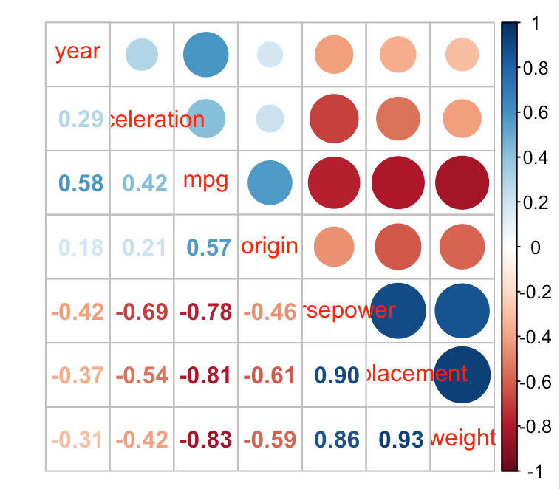
Modeling the MPG using the Auto data Correlations
library(corrplot)
corrplot.mixed(cor(auto_omit_num), order = 'AOE’)
The variables most linear associated with mpg are:
weight (r = -0.83)
displacement (r = -0.81)
horsepower (r = -0.78)
year (r=0.58)
acceleration (r=0.42)

Slide 32
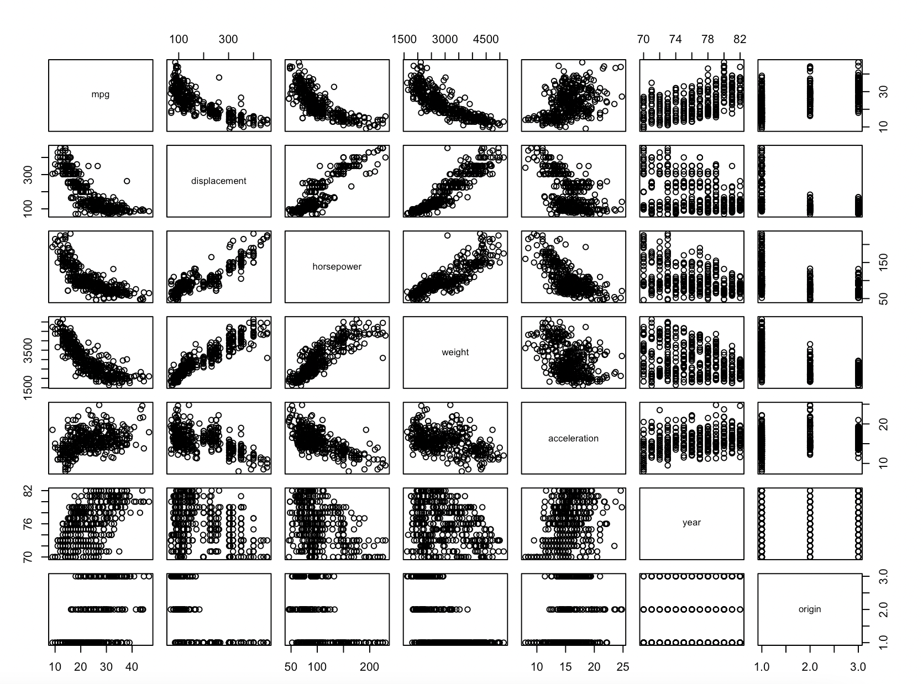
Checking linearity
pairs(auto_omit_num)
Mpg & horsepower
curve
Mpg & displacement
curve
Mpg & weight
curve

Slide 33
Include Weight in the model
Weight has the strongest correlation
The relationship between weight and mpg does not seem linear
lm.fit_auto=lm(mpg~weight, data = auto_omit)
summary(lm.fit_auto)
plot(lm.fit_auto)
Residuals:
Min 1Q Median 3Q Max
-11.9736 -2.7556 -0.3358 2.1379 16.5194
Coefficients:
Estimate Std. Error t value Pr(>|t|)
(Intercept) 46.216524 0.798673 57.87 <2e-16 ***
weight -0.007647 0.000258 -29.64 <2e-16 ***
---
Signif. codes: 0 ‘***’ 0.001 ‘**’ 0.01 ‘*’ 0.05 ‘.’ 0.1 ‘ ’ 1
Residual standard error: 4.333 on 390 degrees of freedom
Multiple R-squared: 0.6926, Adjusted R-squared: 0.6918
F-statistic: 878.8 on 1 and 390 DF, p-value: < 2.2e-16
Negative coefficient
Null Hypothesis: coefficient = 0
P-value <0.05
The null hypothesis is rejected and the coefficient is not 0

Slide 34
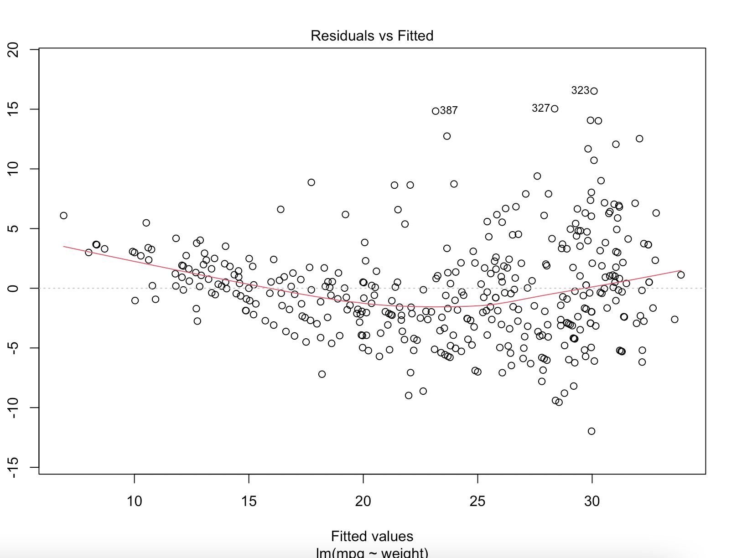
Is there a pattern on the residuals?
The red line on the Residuals versus Fitted is not around 0
THERE IS A PATTEN
ON THE RESIDUALS
The relationship between with mpg and weight does not seem linear

Slide 35
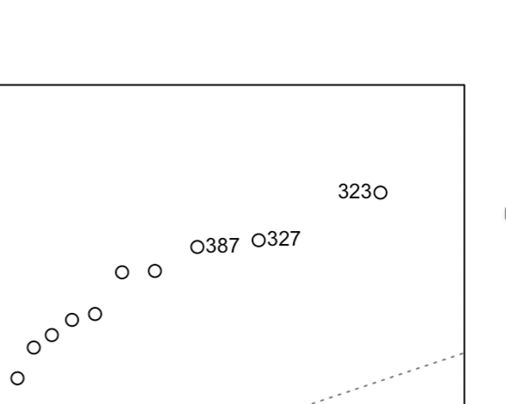
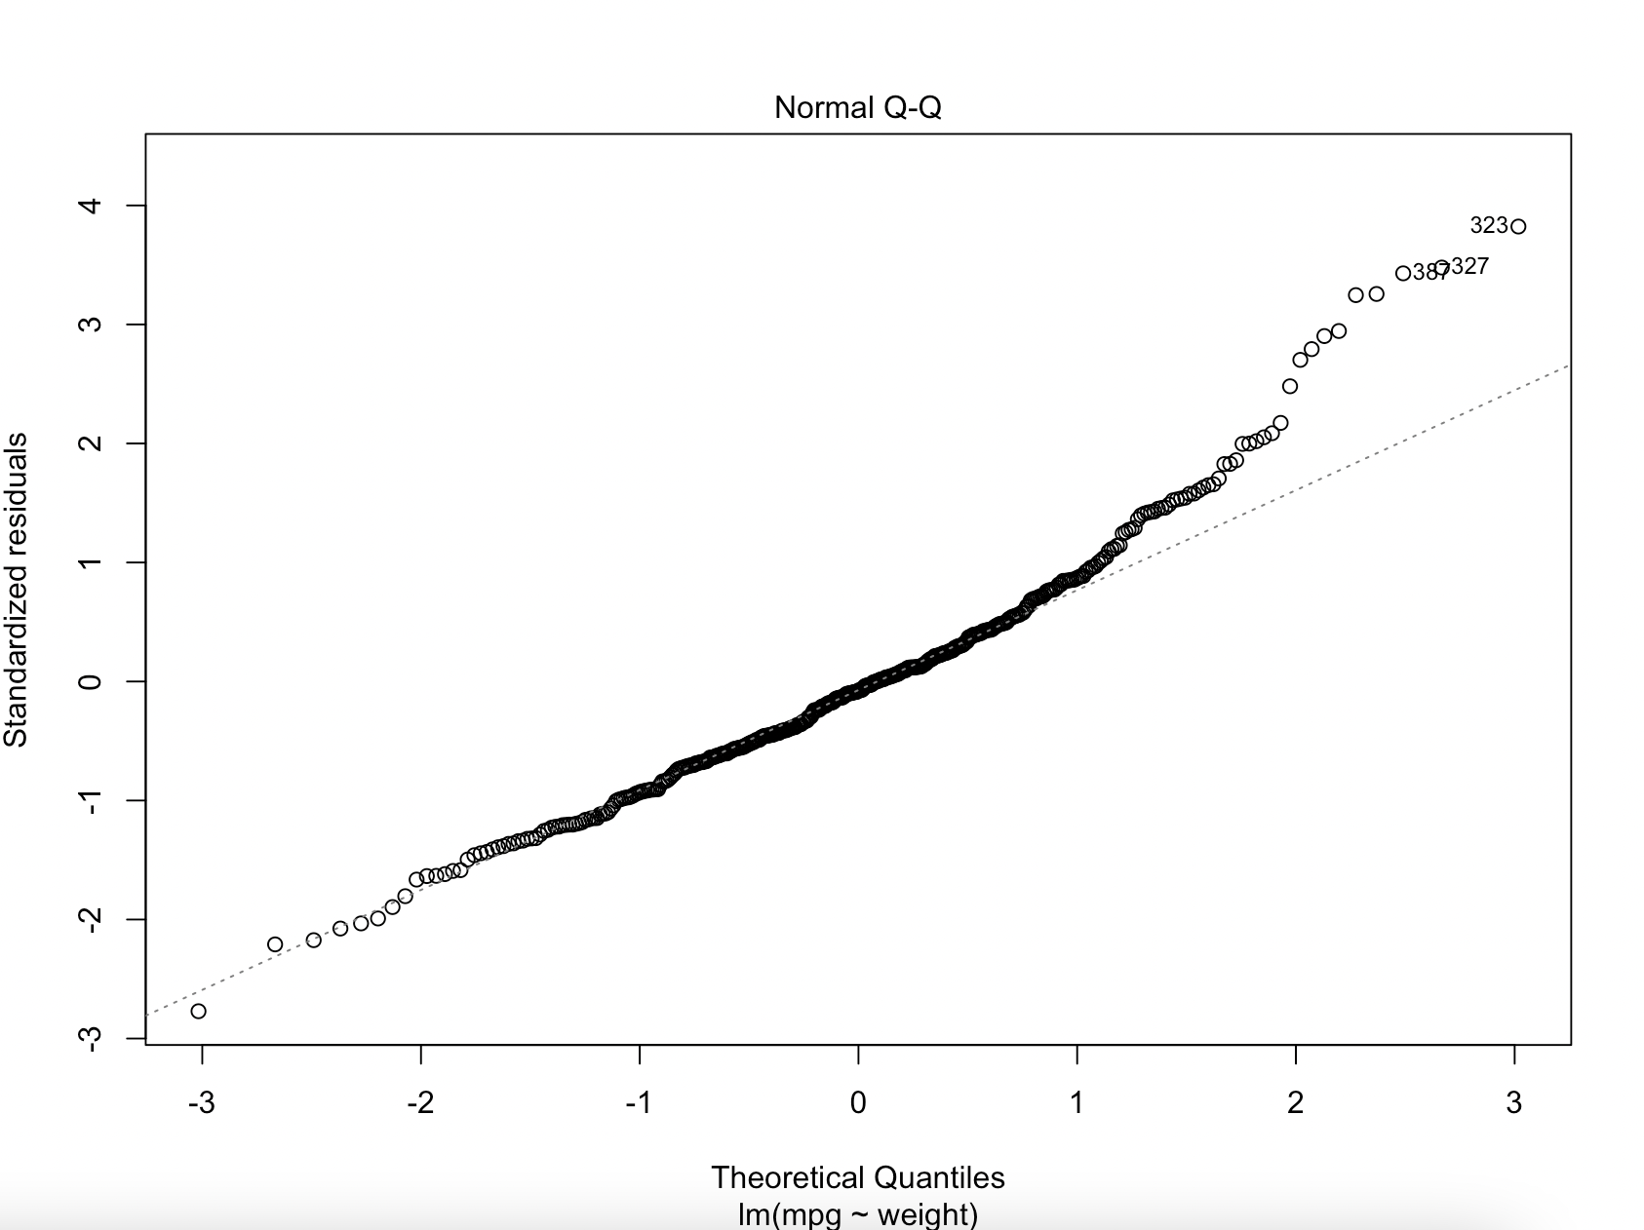
Are there. Outliers?
If the Normal Q-Q plot of the residual does not follow the line, then there are outliers

Slide 36
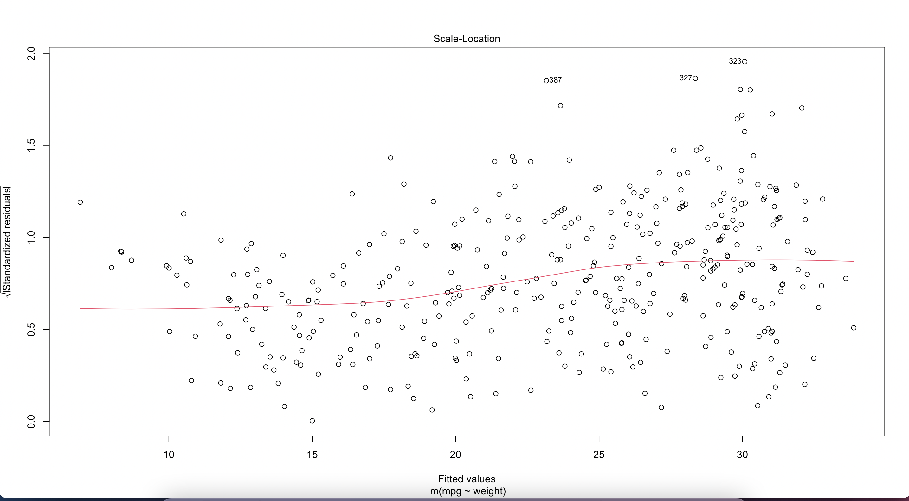
Homoscedasticity or heteroscedasticity?
Can you see a funnel shape on the residuals?
Do large fitted values have larger residuals?
YES

Slide 37
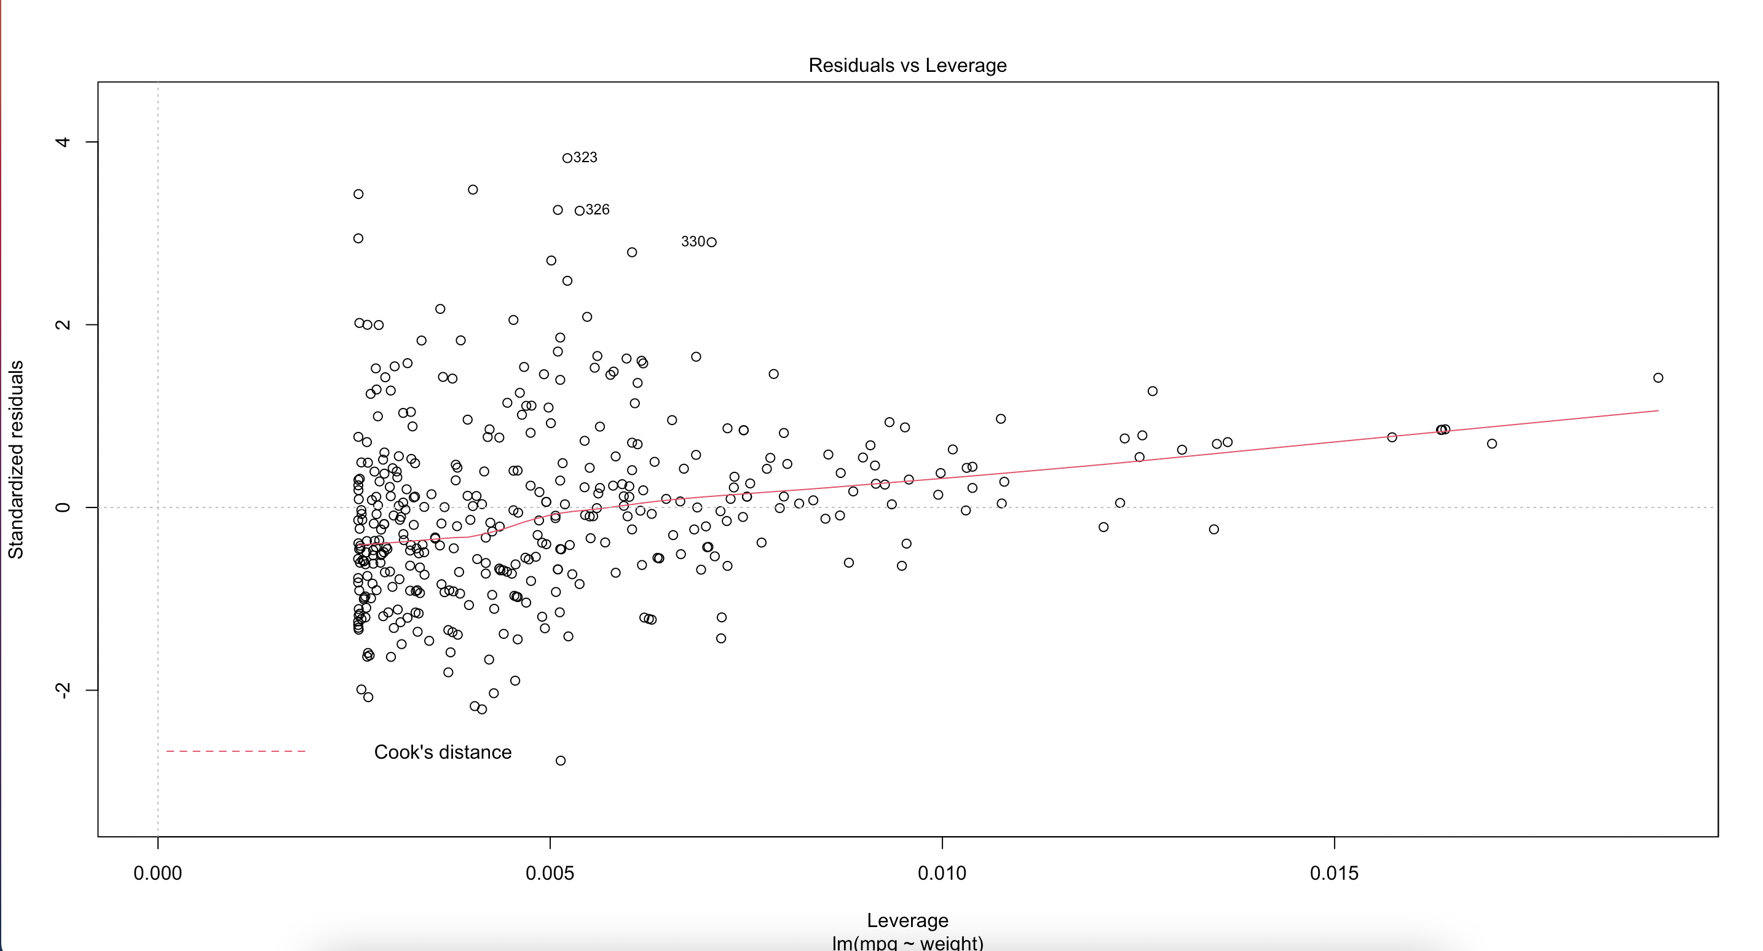
Large leverage points or very influential points?
If there are some leverage much larger than the rest of he leverages. Those are influential.
NO

Slide 38
Next steps:
The model between mpg and weight has patterns on the residuals:
Include quadratic
Use log
Use polynomial
Model | R2 Adjusted | AIC | # large P-values | Residual Patterns | Homoscedasticity | Outliers | Leverage Points
mpg~weight | 69.18% | 1151.5 | 0 | Yes - Include quadratic |  | Yes | No
mpg ~ weight + weight2 | 71.37% | 1123.7 | 0 | No Patterns | Yes | Yes | Yes
mpg ~ log(weight) | 71.19% | 1125.1 | 0 | No Patterns | Yes | Yes | No
The quadratic model has the highest adjusted R-square and the lowest AIC
The log model has no leverage points

Slide 39
Adding displacement to the model
Model | R2 Adjusted | AIC | # large P-values | Residual Patterns | Homoscedasticity | Outliers | Leverage Points
Mpg ~weight | 69.18% | 1151.5 | 0 | Yes - Include quadratic |  | Yes | Yes
mpg ~weight +weight2 | 71.37% | 1123.7 | 0 | No | Yes | Yes | Yes
mpg ~log(weight) | 71.19% | 1125.1 | 0 | No | Yes | Yes | No
mpg ~log(weight) +displacement +dis2 | 72.21% | 1112.5 | 1 | No | Yes | Yes | Yes
mpg ~log(weight) +log(displacement) | 72.08% | 1113.9 | 0 | No | Yes | Yes | Yes

Slide 40
Adding horsepower
Model | R2 Adjusted | AIC | # large P-values | Residual Patterns | Homoscedasticity | Outliers | Leverage Points
Mpg ~weight | 69.18% | 1151.5 | 0 | Yes - Include quadratic |  | Yes | Yes
mpg ~weight +weight2 | 71.37% | 1123.7 | 0 | No | Yes | Yes | Yes
mpg ~log(weight) | 71.19% | 1125.1 | 0 | No | Yes | Ye | No
mpg ~log(weight) +displacement +dis2 | 72.21% | 1112.5 | 1 | No | Yes | Yes | Yes
mpg ~log(weight) +log(displacement) | 72.08% | 1113.9 | 0 | No | Yes | Yes | Yes
mpg ~log(weight) +log(displacement) +poly(horsepower,3) | 74.87% |  | 0 | No | Yes | Yes | Yes

Slide 41
Adding acceleration. Would you include year?
Model | R2 Adjusted | AIC | # large P-values | Residual Patterns | Homoscedasticity | Outliers | Leverage Points
Mpg ~weight | 69.18% | 1151.5 | 0 | Yes - Include quadratic |  | Yes | Yes
mpg ~weight +weight2 | 71.37% | 1123.7 | 0 | No | Yes | Yes | Yes
mpg ~log(weight) | 71.19% | 1125.1 | 0 | No | Yes | Yes | No
mpg ~log(weight) +displacement +dis2 | 72.21% | 1112.5 | 1 | No | Yes | Yes | Yes
mpg ~log(weight) +log(displacement) | 72.08% | 1113.9 | 0 | No | Yes | Yes | Yes
mpg ~log(weight) +log(displacement) +poly(horsepower,5) | 75.24% | 1071.6 | 1 | No | Yes | Yes | Yes
mpg ~log(weight) +log(displacement) +poly(horsepower,5) +poly(acceleration,5) | 75.95% collinearity | between | 8 acceleration | No and | Yes horsepower | Yes | Yes
mpg ~log(weight) +log(displacement) +poly(horsepower,5) +year | 85.76% collinearity | between | 6 year | and | horsepower
mpg ~log(weight) +log(displacement) +horsepower3 +year | 84.07% |  | 0
Acceleration odes not provide any extra information for mpg
Acceleration and horsepower were highly correlated

Slide 42
Using a step forward
min.model = lm(mpg ~ 1, data = auto_omit)
summary(min.model)
m.best.forward = step(min.model, direction='forward',
scope=(mpg ~weight +weight2+log(weight) + displacement+displacement2+displacement3+displacement4+displacement5 +log(displacement) + horsepower+horsepower2+horsepower3+horsepower4+horsepower5+log(horsepower) +
acceleration +acceleration2 +acceleration3 +acceleration4 +acceleration5 +log(acceleration) +
weight*horsepower),
test = 'F', trace=T)
summary(m.best.forward)
plot(m.best.forward)
Model Using Forward Stepwise | R2 Adjusted | AIC | # large P-values | Residual Patterns | Homoscedasticity | Outliers | Leverage Points
mpg ~ 1 |  | 1611.9
mpg ~log(weight) | 71.19% | 1125.1 | 0 | No | Yes | Yes | No
mpg ~log(weight) +log(horsepower) |  | 1088.5
mpg ~log(weight) +log(horsepower) +horsepower2 |  | 1079.1
mpg ~log(weight) +log(horsepower) +horsepower2 +log(acceleration) |  | 1074.7
mpg ~log(weight) +log(horsepower) +horsepower2 +log(acceleration) +log(displacement) | 75.51% | 1065.4 | 1 | No | Yes | Yes | Yes
mpg ~log(horsepower) +horsepower2 +log(acceleration) +log(displacement) | 75.38% |  | 0 |  |  | 323, 387

Slide 43
Explore forward step-wise model
lm.fitsf1 =l m(mpg ~ log(horsepower) + horsepower2 + log(acceleration) + log(displacement),data=auto_omit)
summary(lm.fitsf1)
plot(lm.fitsf1)
Residuals:
Min 1Q Median 3Q Max
-12.4060 -2.2728 -0.2739 1.8326 16.1990
Coefficients:
Estimate Std. Error t value Pr(>|t|)
(Intercept) 1.653e+02 9.375e+00 17.631 < 2e-16 ***
log(horsepower) -1.982e+01 2.011e+00 -9.855 < 2e-16 ***
horsepower2 2.085e-04 5.423e-05 3.844 0.000141 ***
log(acceleration) -8.956e+00 1.638e+00 -5.467 8.22e-08 ***
log(displacement) -5.675e+00 7.863e-01 -7.218 2.81e-12 ***
---
Signif. codes: 0 ‘***’ 0.001 ‘**’ 0.01 ‘*’ 0.05 ‘.’ 0.1 ‘ ’ 1
Residual standard error: 3.872 on 387 degrees of freedom
Multiple R-squared: 0.7564, Adjusted R-squared: 0.7538
F-statistic: 300.4 on 4 and 387 DF, p-value: < 2.2e-16

Slide 44
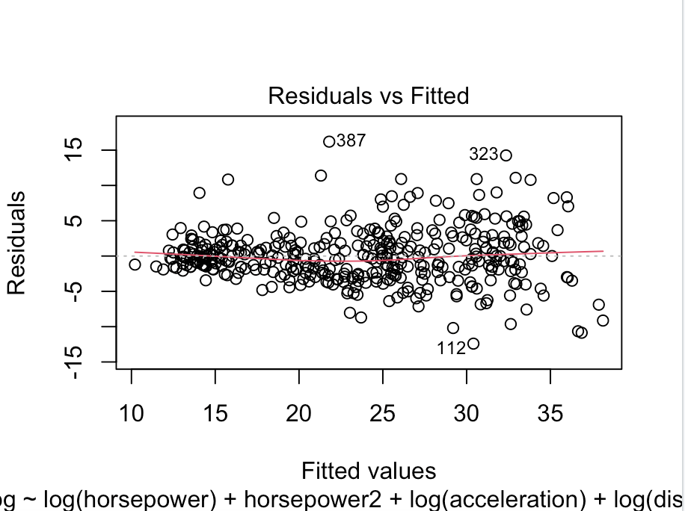
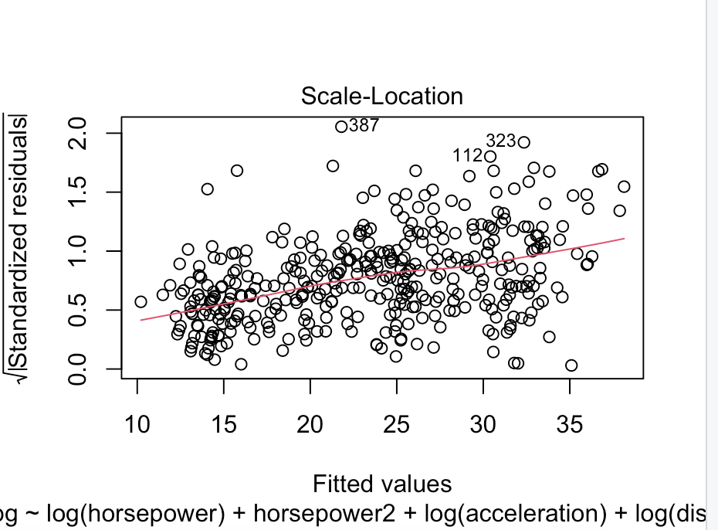
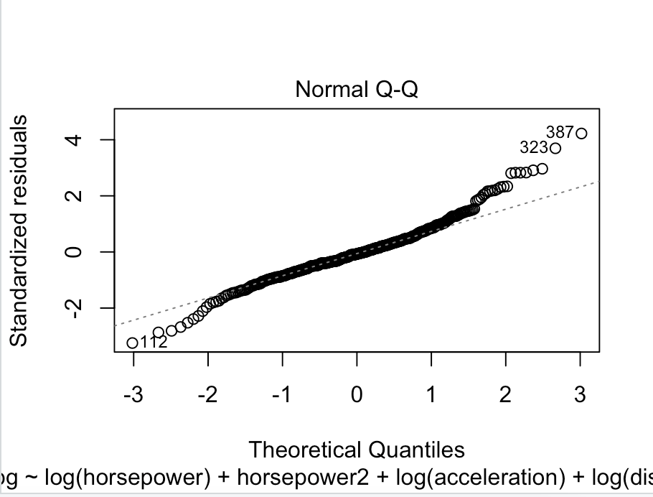
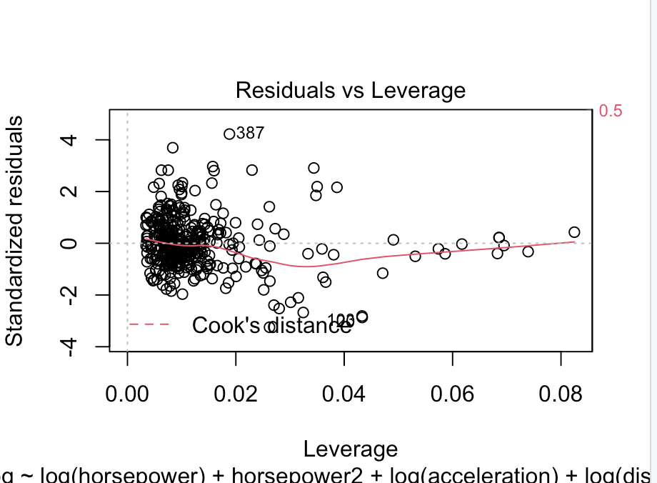
Explore forward step-wise model
No residual patterns
There are outliers: 387, 323
No heteroscedasticity issues
No large leverage points

Slide 45
Check on Residuals
auto_omit[387,]
auto_omit[323,]
 | mpg | cylinders | displacement | horsepower | weight | acceleration | year
Q1 | 17 |  | 105 | 75 | 2225 | 14 | 73
Median | 22.75 |  | 151 | 93 | 2804 | 16 | 76
Q3 | 29 |  | 276 | 126 | 3615 | 17.02 | 79
323 | 40.8 | 4 | 85 | 65 | 2110 | 19.2 | 80
387 | 27 | 4 | 151 | 90 | 2950 | 17.3 | 82
The 323 Outlier seem to be belonging to a very efficient car. The actual value of mpg is larger than the predicted value
The outlier 387 is among the 50 to 75% efficient level. The actual car is more efficient that the prediction (positive residual)

Slide 46
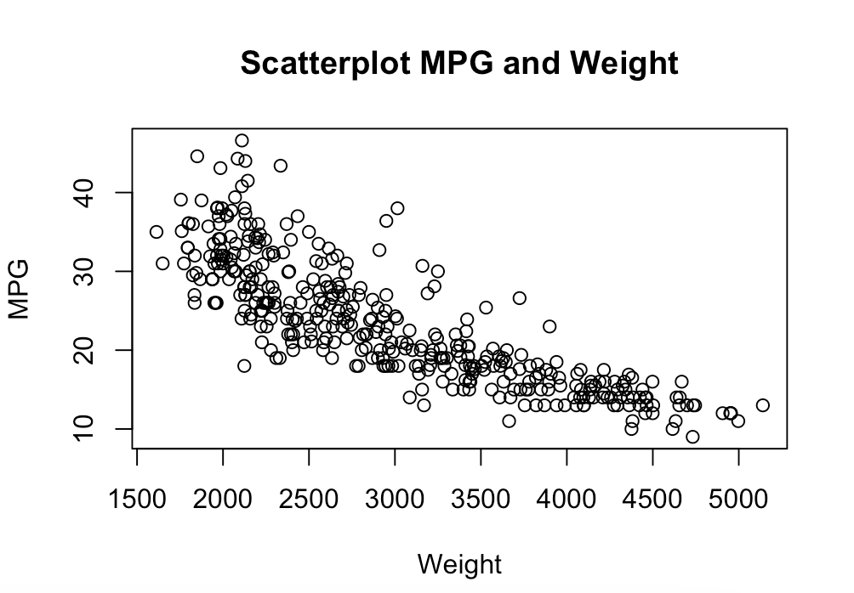
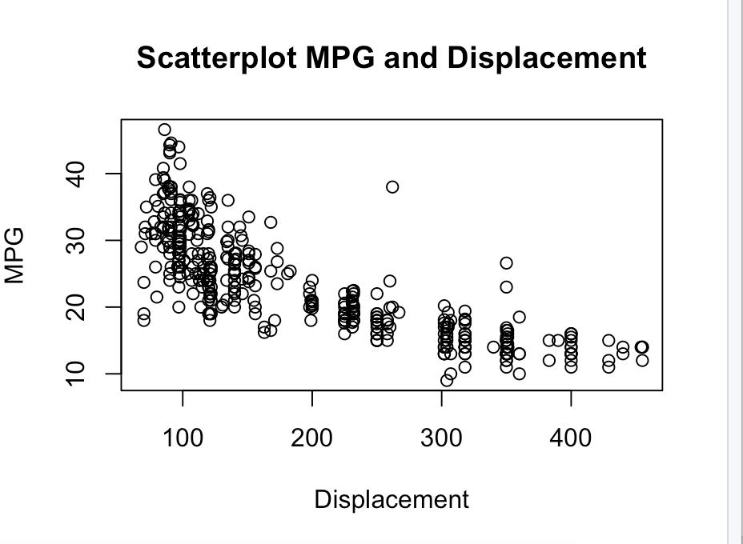
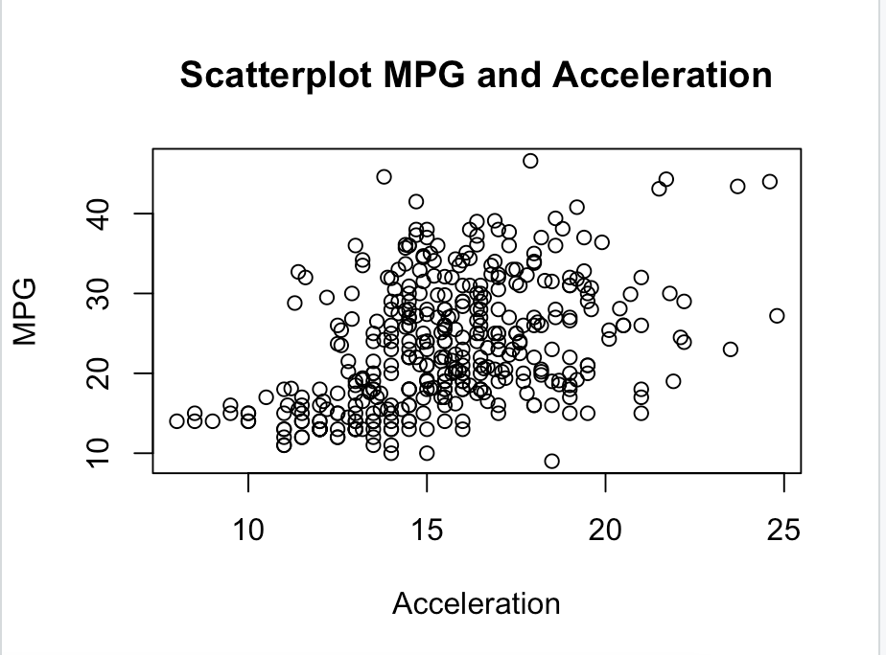
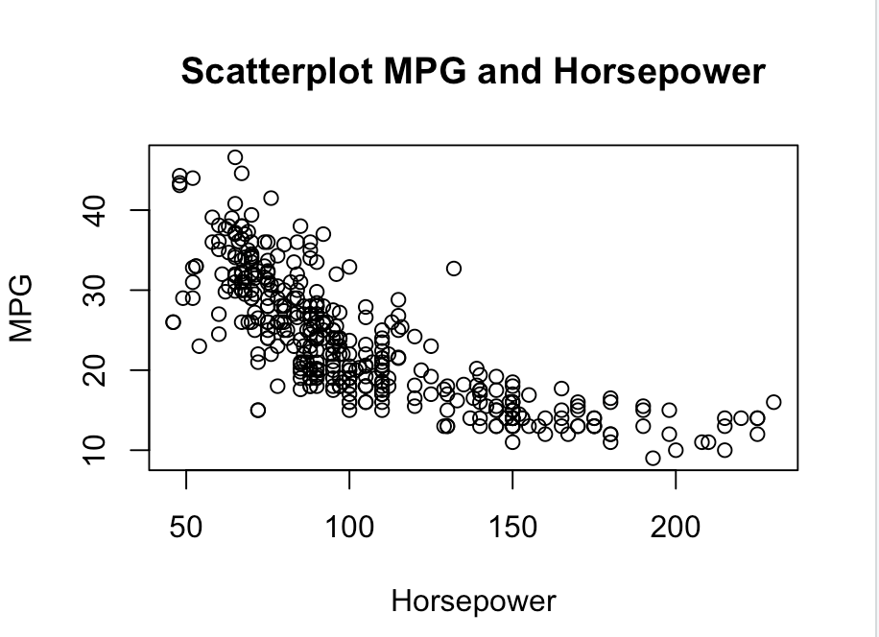
Check on Residuals
Car 323 is more efficient than cars of similar weight, displacement, horsepower and acceleration. It is a car from the 80s. Should you remove it and check if the model improves without it?
# how to remove specific rows in R
removed2_cars <- auto_omit[-c(323,387),]
dim(auto_omit)
dim(removed2_cars)
Car 323:
mpg = 40.8
weight = 2,110
Displacement = 85
Horsepower = 65
Acceleratio = 19.2
Car 387:
mpg = 27
weight = 2,950
Displacement = 151
Horsepower = 90
Acceleration = 17.3

Slide 47
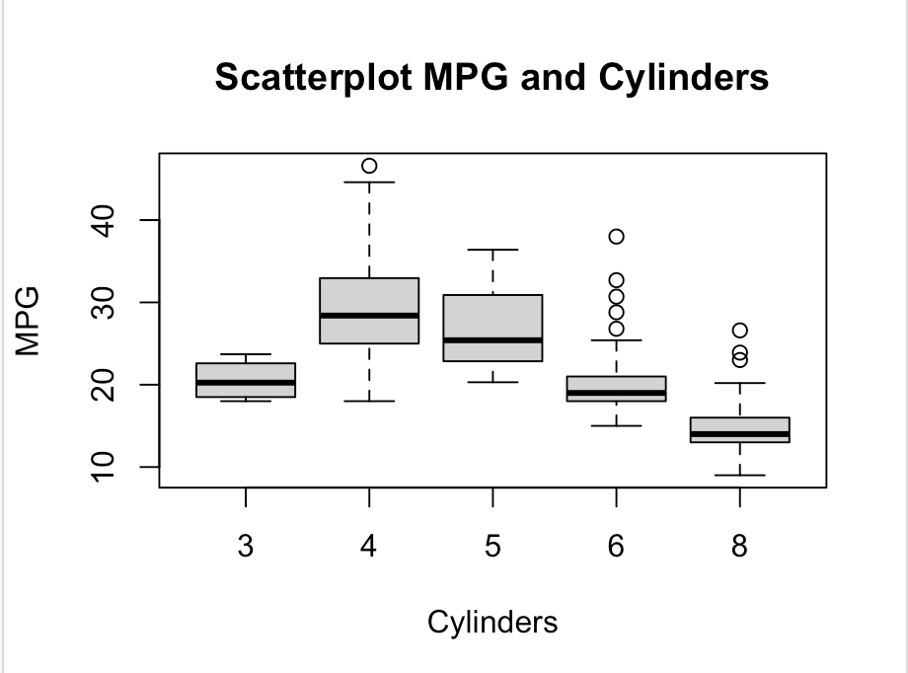
Can cylinders be included in the model?
Cylinders is a categorical. variable Dummies can be included in the model
#Dummies
library(fastDummies)
auto_omit <- dummy_cols(auto_omit,select_columns = "cylinders")
auto_omit
#New dummies: cylinders_3, cylinders_4, cylinders_5, cylinders_6 and cylinders_8
Model Using Forward Stepwise | R2 Adjusted | AIC | # large P-values | Residual Patterns | Homoscedasticity | Outliers | Leverage Points
mpg ~log(weight) +log(horsepower) +horsepower2 |  | 1079.1
mpg ~log(horsepower) +horsepower2 +log(acceleration) +log(displacement) | 75.38% |  | 0 | No | Yes | 323, 387 | No
mpg ~log(horsepower) +horsepower2 +log(acceleration) +log(displacement) + cylinders_4 | 76.05% |  | 0 | No | Yes | 382, 321, 331 | No
mpg ~log(horsepower) +horsepower2 +log(acceleration) +log(displacement) + cylinders_3 | 76.67% |  | 0 | No | Yes | 382, 321, 389 | Yes 111

Slide 48
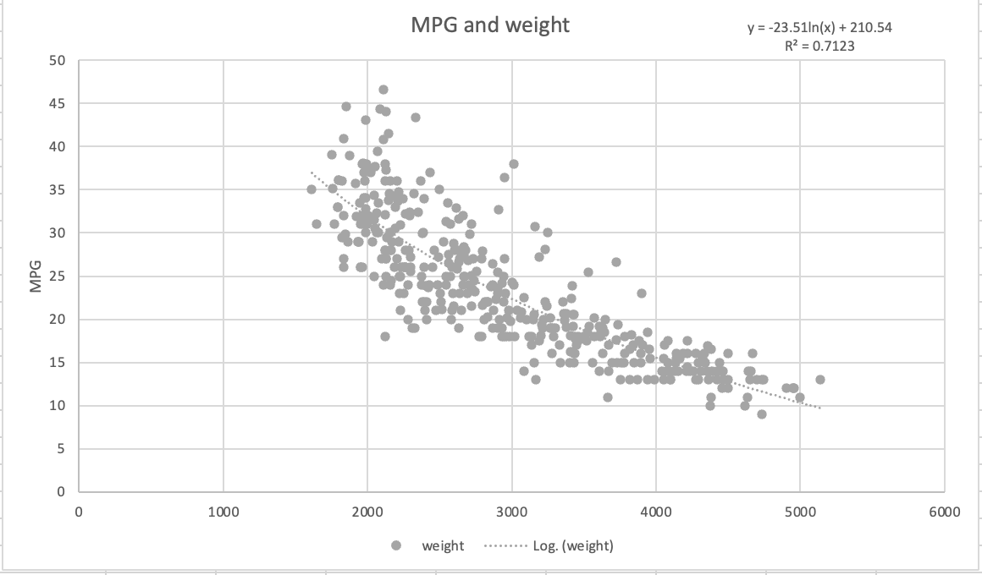
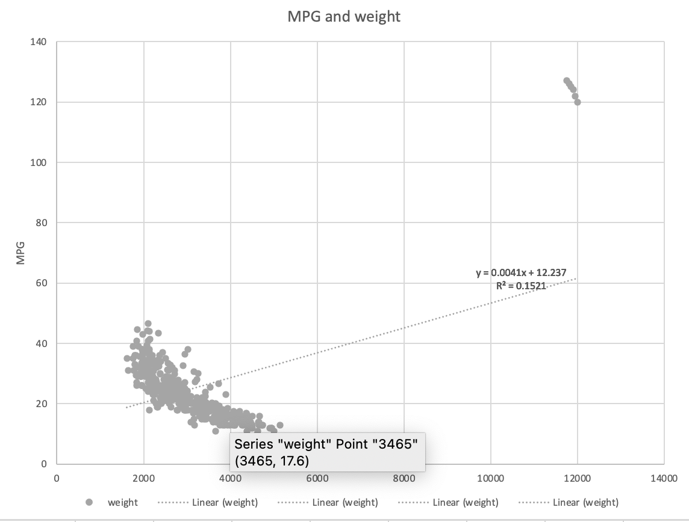
Large Leverage Point:
The top scatterplot includes all cars from auto data set
Mpg = -23.51*ln(weight)+210
R-square = 71%
The bottom plot includes 6 additional heavy efficient car. Those cars change the model
Mpg = 0.0041*weight+12
R-square = 15%
Those 6 additional cars are very influential cars and do not help on modeling the cars of the auto dataset. Those characteristics are very different to the cars in the auto dataset

Slide 49
To Do:
Study for Midterm
Visualizing categorical and numerical variables
Variables proportions and distributions
Visualizing bivariate plots
Meaning of correlations and linear association
Sampling concepts
How to select a Simple Random Sample
Inference
Two groups comparison
Linear regression
Multivariate regression

Slide 50
Model Accuracy on Testing Set or Hold-out period
The Model is estimated on the Training Set (80%)
The Model is evaluated on the Testing Set (20%)or Hold-Out Period (Time Series data – most recent Period)
Regression - Mean Square Error
Classifier – Accuracy

